Slide 1

IBM Services

Slide 2
What is computer vision
Computer vision is a branch of science that is concerned with processing images to extract, analyze, and understand useful information from a single image or image sequence.
It aims at simulating the human visual system.
It uses various machine learning and deep learning algorithms to analyze images for scenes, objects, faces, and other content in videos, photos, and pictures in general.
Notes:
Computer vision is a branch of science that is concerned with processing images to extract, analyze, and understand useful information from a single image or image sequence. It aims to create an artificial (computer) system that can achieve the capabilities of a human visual system so that the machine can “see”.
CV uses various machine learning algorithms to analyze images for scenes, objects, faces, and other content in videos, photos, and pictures in general.
References:
The British Machine Vision Association
https://britishmachinevisionassociation.github.io/
What is computer vision?
https://www.ibm.com/topics/computer-vision?mhsrc=ibmsearch_a&mhq=computer%20vision%20history

Slide 3
How does computer vision work
Two essential technologies are used in computer vision: deep learning and a convolutional neural network (CNN).
Deep learning is a subset of machine learning where neural network — algorithms inspired by the human brain — learn from large amounts of data.
A CNN helps a deep learning model by breaking down images into pixels that are given tags or labels. It uses the labels to perform convolutions (a mathematical operation on two functions to produce a third function) and makes predictions about what it is “seeing.”
Deep learning is similar to a traditional neural network, but it has many more hidden layers.
The more complex the problem, the more hidden layers are in the model.
Deep learning algorithms perform a task repeatedly and gradually improve the outcome through deep layers that enable progressive learning.
Notes:
Computer vision needs lots of data. It runs analyses of data over and over until it discerns distinctions and ultimately recognize images. For example, to train a computer to recognize automobile tires, it needs to be fed vast quantities of tire images and tire-related items to learn the differences and recognize a tire, especially one with no defects.
Two essential technologies are used to accomplish this goal: a type of machine learning called deep learning and a convolutional neural network (CNN).
Machine learning uses algorithmic models that enable a computer to teach itself about the context of visual data. If enough data is fed through the model, the computer will “look” at the data and teach itself to tell one image from another. Algorithms enable the machine to learn by itself, rather than someone programming it to recognize an image.
A CNN helps a machine learning or deep learning model “look” by breaking down images into pixels that are given tags or labels. It uses the labels to perform convolutions (a mathematical operation on two functions to produce a third function) and makes predictions about what it is “seeing.” The neural network runs convolutions and checks the accuracy of its predictions in a series of iterations until the predictions start to come true. It is then recognizing or seeing images in a way similar to humans.
Much like a human making out an image at a distance, a CNN first discerns hard edges and simple shapes, then fills in information as it runs iterations of its predictions. A CNN is used to understand single images. A recurrent neural network (RNN) is used in a similar way for video applications to help computers understand how pictures in a series of frames are related to one another.
References:
What is computer vision?
https://www.ibm.com/topics/computer-vision?mhsrc=ibmsearch_a&mhq=computer%20vision%20history
Deep learning
https://www.ibm.com/cloud/watson-studio/deep-learning
What is deep learning?
https://www.ibm.com/cloud/learn/deep-learning?mhsrc=ibmsearch_a&mhq=deep%20learning#toc-what-is-de-6i8FHi1_
What are convolutional neural networks?
https://www.ibm.com/cloud/learn/convolutional-neural-networks#toc-what-are-c-MWGVhUiG

Slide 4
How does computer vision work (cont.)
A recurrent neural network (RNN) is a type of artificial neural network which uses sequential data or time series data.
RNN are typically used in natural language and speech recognition applications as it leverages sequential or times series data.
While a CNN is used to understand single images. A recurrent neural network (RNN) is used in a similar way for video applications to help computers understand how pictures in a series of frames are related to one another.
Notes:
Different types of neural networks address specific problems or data sets. For example, Convolutional neural networks (CNNs), are used primarily in computer vision and image classification applications. CNNs can detect features and patterns within an image, enabling tasks, like object detection or recognition. In 2015, a CNN bested a human in an object recognition challenge for the first time.
Recurrent neural network (RNNs) are typically used in natural language and speech recognition applications as they leverage sequential or times series data.
Much like a human making out an image at a distance, a CNN first discerns hard edges and simple shapes, then fills in information as it runs iterations of its predictions. A CNN is used to understand single images. A recurrent neural network (RNN) is used in a similar way for video applications to help computers understand how pictures in a series of frames are related to one another.
References:
What is computer vision?
https://www.ibm.com/topics/computer-vision?mhsrc=ibmsearch_a&mhq=computer%20vision%20history
Deep Learning
https://www.ibm.com/cloud/learn/deep-learning?mhsrc=ibmsearch_a&mhq=deep%20learning#toc-what-is-de-6i8FHi1_
Recurrent Neural Networks
https://www.ibm.com/cloud/learn/recurrent-neural-networks
Convolutional neural networks (CNNs),
https://www.ibm.com/cloud/learn/convolutional-neural-networks
Recurrent neural network (RNNs)
https://www.ibm.com/cloud/learn/recurrent-neural-networks

Slide 5
Computer vision history
1959: Image processing starts with simple shapes like straight edges when neurophysiologists showed a cat an array of images, attempting to correlate a response in its brain.
1963: Computers were able to transform two-dimensional images into three-dimensional forms.
1974: The introduction of optical character recognition (OCR) technology, which could recognize text that is printed in any font or typeface. Similarly, intelligent character recognition (ICR) could decipher hand-written text by using neural networks.
1982: Algorithms are introduced for machines to detect edges, corners, curves, and similar basic shapes. Concurrently, convolutional layers in a neural network are introduced.
2000: The focus of study was on object recognition.
2001: The first real-time face recognition applications appeared.
2010: The ImageNet data set became available. It contained millions of tagged images across a thousand object classes and provides a foundation for the CNNs and deep learning models that are used today.
2012: CNN is entered into an image recognition contest. The AlexNet model significantly reduced the error rate for image recognition.
Notes:
The slide shows a brief timeline that depicts the most important milestones in computer vision research and development.
Reference:
The history of computer vision
https://www.ibm.com/topics/computer-vision?mhsrc=ibmsearch_a&mhq=computer%20vision%20history

Slide 6
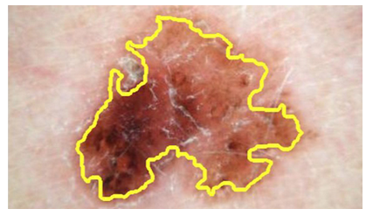
Computer vision applications
Manufacturing: Ensure that products are being positioned correctly on an assembly line.
Visual auditing: Look for visual compliance or deterioration in a fleet of trucks, planes, windmills, transmission or power towers , and so on.
Insurance: Classify claims images into different categories.
Medical image processing: Detect tumors.
Automotive industry: Object detection for safety.
Identifying skin cancer by using CV
Notes:
CV can be used in many applications and industries:
Manufacturing: Use images from a manufacturing setting to make sure that products are being positioned correctly on an assembly line, or ensure product quality by identifying defective parts on the production line instead of by using manual validation.
Visual auditing: Look for visual compliance or deterioration in a fleet of trucks, planes, or windmills, etc.. in the field. Train custom models to understand what defects look like.
Insurance: Rapidly process claims by using images to classify claims into different categories.
Social listening: Use images from your product line or your logos to track buzz about your company on social media.
Medical image processing: Using images for diagnosing patients, such as the detection of tumors.
Automotive industry: There are many applications for CV in cars. For example, while parking a car, a camera can detect objects and warn the driver when they get too close to them.
Reference:
Computer vision
https://www.research.ibm.com/artificial-intelligence/computer-vision/

Slide 7


Computer vision applications (cont.)
Social commerce: Use an image of a house to find similar homes that are for sale.
Social listening: Track the buzz about your company on social media by looking for product logos.
Retail: Use the photo of an item to find its price at different stores.
Education: Use pictures to find educational material on similar subjects.
Public safety: Automated license-plate reading.
Company’s logo search
Interactive image search
Notes:
Social commerce: Use an image of a house to find similar homes that are for sale.
Social listening: Use images from your product line or your logos to track buzz about your company on social media.
Retail: Use the photo of an item to find its price at different stores.
Education: Use pictures to find educational material on similar subjects.
Public safety: Automated license-plate reading.
Do you know of or heard of any other applications?
Reference:
Computer vision
https://www.research.ibm.com/artificial-intelligence/computer-vision/

Slide 8
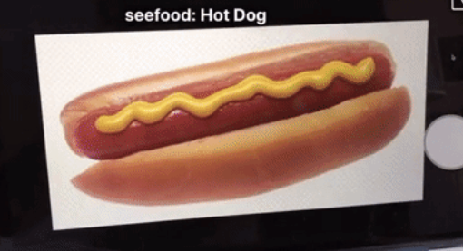
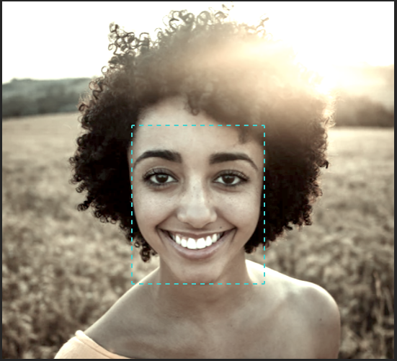
Computer vision tasks
Image classification: predict that a given image belongs to a certain class.
Example: See binary image classification demo at https://developer.ibm.com/developer/default/articles/introduction-computer-vision/images/hotdognothotdog.gif
The demo shows a model that classifies an image as a hotdog or not a hot dog.
The video is just a sequence of images (frames). The current frame is either recognized as a hotdog or not.
A social media company wants to automatically identify, and segregate objectionable images that are uploaded by users.
Object detection and recognition: Detect certain patterns within the image.
Examples:
Detect red eyes when taking photos in certain conditions.
Face recognition.
Notes:
Image classification sees an image and can classify it (a dog, an apple, a person’s face). More precisely, it can accurately predict that an image belongs to a certain class. For example, a social media company might want to use it to automatically identify and separate objectionable images that are uploaded by users.
The demo shows what you can do with a video and a simple model. Notice that instead of images, it was built by using a video, which is just a sequence of images (frames). The current frame is either recognized as a hotdog or not.
A CV task represents a well-defined problem in CV that can be solved to a certain extent or accuracy by using one method or another.
Object detection and recognition deals with locating and detecting certain patterns within the image. For example, detecting red eyes when taking photos in certain conditions. Other applications include face detection and face recognition.
A CV task is also used in tracking objects, for example, tracking a ball during a football match, tracking the movement of a cricket bat, or tracking a person in a video.
References:
Binary image classification demo
https://developer.ibm.com/developer/default/articles/introduction-computer-vision/images/hotdognothotdog.gif
What is computer vision?
https://www.ibm.com/topics/computer-vision?mhsrc=ibmsearch_a&mhq=object%20detection
Introduction to computer vision
https://developer.ibm.com/articles/introduction-computer-vision/

Slide 9
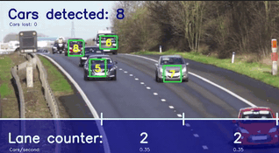
Computer vision tasks (cont.)
Object tracking: Following the position changes of a target object from one frame to another in an image sequence or video.
Example: Autonomous vehicles need to not only classify and detect objects such as pedestrians, other cars and road infrastructure, they need to track them in motion to avoid collisions and obey traffic laws
“Detect, track, and count cars in a video” provides an example to show you how the object tracking code pattern is used for object detection along with object tracking to annotate a video and count cars.
Notes:
Object tracking is a deep learning application that follows the changes in the position of a target object from one frame to another within an image sequence or video.
Follows or tracks an object once it is detected. This task is often run with images that are captured in sequence or real-time video feeds. Example: Autonomous vehicles need to not only classify and detect objects such as pedestrians, other cars, and road infrastructure, they need to track them in motion to avoid collisions and obey traffic laws.
“Detect, track, and count cars in a video” provides an example to show you how the object tracking code pattern is used for object detection along with object tracking to annotate a video and count cars.
This code pattern shows you how to create and use a classifier to identify objects in motion and then track the objects and count them as they enter designated regions of interest.
References:
Detect, track, and count cars in a video
https://github.com/IBM/powerai-counting-cars/blob/master/README.md#detect-track-and-count-cars-in-a-video
Cars detected demo GIF
https://raw.githubusercontent.com/IBM/powerai-counting-cars/master/doc/source/images/output-video-as-gif.gif
Computer vision
https://en.wikipedia.org/wiki/Computer_vision
APA citation for image: Sidenbladh, H., Black, M. J., & Fleet, D. J. (2000, June). Stochastic tracking of 3D human figures using 2D image motion. In European conference on computer vision (pp. 702-718). Springer, Berlin, Heidelberg.
What is computer vision
https://www.ibm.com/topics/computer-vision?mhsrc=ibmsearch_a&mhq=object%20detection
Introduction to computer vision
https://developer.ibm.com/articles/introduction-computer-vision/

Slide 10
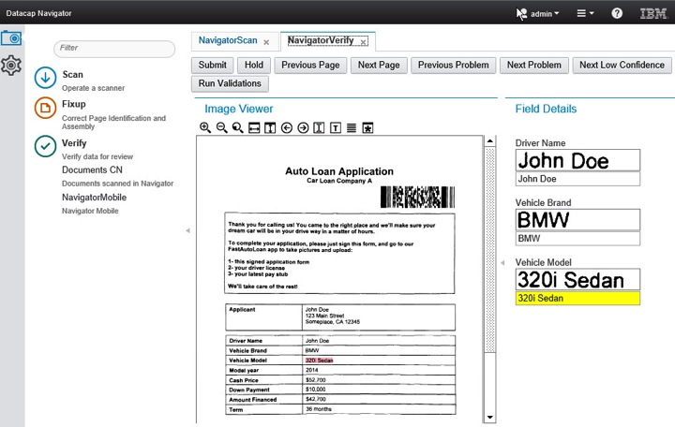
Computer vision tasks (cont.)
Content-based image retrieval: Image retrieval from a database based on user’s image query.
By using image actual feature contents such as colors, shapes, and textures
Not using image metadata (keywords, tags, or descriptions)
Optical character recognition (OCR): Converting hand-written text to a digital format.
Notes:
Content-based image retrieval or “query-by image content” (QBIC) is the retrieval of images from a database by using an image as a query. IBM was one of the pioneers in developing QBIC at the IBM Almaden Research Center. "Content-based" refers to actual feature contents of the image like colors, shapes, and textures. Other image retrieval systems rely on image metadata such as keywords, tags, or descriptions that are associated with the image instead of image content. Content-based image retrieval is preferred because searches that rely purely on metadata depend on the quality of annotation.
Content-based image retrieval uses computer vision to browse, search, and retrieve images from large data stores, based on the content of the images rather than metadata tags associated with them. This task can incorporate automatic image annotation that replaces manual image tagging. These tasks can be used for digital asset management systems and can increase the accuracy of search and retrieval.
Optical character recognition (OCR): Scan papers and hand-written forms, identify the characters in them, and transform them into digital format (strings).
References:
Content-based Multimedia Information Retrieval: State of the Art and Challenges http://www.ugmode.com/prior_art/lew2006cbm.pdf
What is computer vision?
https://www.ibm.com/topics/computer-vision?mhsrc=ibmsearch_a&mhq=object%20detection
Digital Asset Management
https://www.ibm.com/topics/digital-asset-management

Slide 11
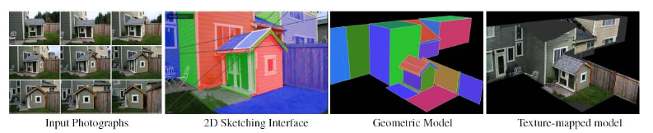
Computer vision tasks (cont.)
Image restoration: Fixing and restoring images that are corrupted by noise, such as motion blur, to their default state.
Scene reconstruction: Creation of a 3D model by supplying the system with multiple 2D images from different views. The computer constructs a 3D model based on those images.
(Sinha, Steedly, Szeliskiet al. 2008) © 2008 ACM.
Notes:
Image restoration: Fixing and restoring images that are corrupted by noise, such as motion blur, to their default state.
Scene reconstruction: Creation of 3D model by supplying the system with multiple 2D images from different views. The computer constructs a 3D model based on those images.
References:
Computer vision
https://en.wikipedia.org/wiki/Computer_vision
APA image citation: Sinha, S. N., Steedly, D., Szeliski, R., Agrawala, M., & Pollefeys, M. (2008, December). Interactive 3D architectural modeling from unordered photo collections. In ACM Transactions on Graphics (TOG) (Vol. 27, No. 5, p. 159). ACM.

Slide 12
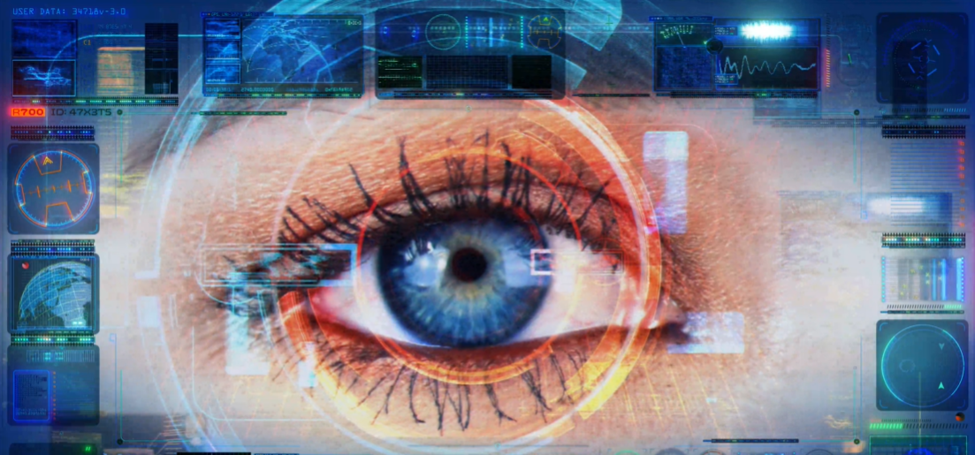
Computer vision tools
OpenCV: CV open source library
C++, Python, Java, and MATLAB interfaces
PyTorchCV is based on PyTorch framework.
Used for various computer vision tasks.
Includes a collection of pretrained models for image classification, segmentation, detection, and pose estimation.
scikit-image is an open source library for image processing.
Includes a set of algorithms for image processing.
Implements algorithms and utilities that are used in research, education, and industry applications.
Well-documented API in the Python programming language.
Notes:
This slide provides examples of open source tools for computer vision.
OpenCV is an open source library that can be used to perform most computer vision tasks that are required on several languages. It includes C++, Python, Java, and MATLAB interfaces.
PyTorchCV is based on the PyTorch framework. It is used for various computer vision tasks. It included a collection of pretrained models for image classification, segmentation, detection, and pose estimation.
scikit-image is an open source image-processing library for the Python programming language. It includes algorithms for segmentation, geometric transformations, color space manipulation, analysis, filtering, morphology, feature detection, and more. It is available free of charge.
References:
pytorchcv 0.0.67
https://pypi.org/project/pytorchcv/
Scikit-image
https://scikit-image.org/
scikit-image
https://en.wikipedia.org/wiki/Scikit-image

Slide 13
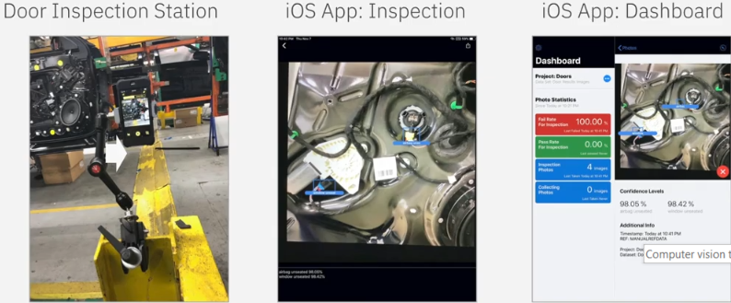
Computer vision tools (cont.)
IBM Maximo Visual Inspection
Makes computer vision with deep learning more accessible to business users.
Includes a toolset that subject matter experts (SMEs) can use to label, train, and deploy deep learning vision models.
No coding or deep learning expertise is required.
Benefits: Identify defects faster with visual inspection powered by AI
Improve uptime and reduce defects
Enable quick action and issue resolution
Empower SMEs
Notes:
Several vendors, such as IBM, Microsoft, and Google provide computer vision offerings.
IBM Maximo Visual Inspection makes computer vision with deep learning more accessible to business users. IBM Maximo Visual Inspection includes an intuitive toolset that empowers subject matter experts to label, train, and deploy deep learning vision models, without coding or deep learning expertise. It includes the most popular deep learning frameworks and their dependencies, and it is built for easy and rapid deployment and increased team productivity. By combining IBM Maximo Visual Inspection software with off the shelf mobile and edge devices, enterprises can rapidly deploy a fully optimized and supported platform with excellent performance.
Some of its benefits are:
Improve uptime and reduce defects Use deep learning to analyze processes and outputs to continually improve error and defect detection and perform root-cause analysis.
Enable quick action and issue resolution AI can spot issues within milliseconds and can quickly alert the right resource to inspect, diagnose, and rectify any issue, anywhere.
Empower any subject matter expert The streamlined user interface allows domain experts to easily bring data and train models. Users with limited deep learning skills can build models for AI solutions.
For a list of use cases, see IBM Maximo Visual Inspection at https://www.ibm.com/downloads/cas/K78GEROY
References:
Getting started with IBM Maximo Visual Inspection https://developer.ibm.com/series/learning-path-powerai-vision/?mhsrc=ibmsearch_a&mhq=Getting%20started%20with%20IBM%20Maximo%20Visual%20Inspection
IBM Maximo Visual Inspection
https://www.ibm.com/downloads/cas/K78GEROY

Slide 14
Computer vision tools (cont.)
IBM Cloud Annotations
Makes labeling images and training machine learning models easy.
Supports both photos and videos.
Object detection: An object detection model provides the following information:
Type of object and prediction confidence level
Location: The coordinates and area of where the object is in the image.
Count: The number of objects found in the image.
Size: How large the object is with respect to the image dimensions.
Object classification: An object classification model provides the following information
Type of object and prediction confidence level
To use Cloud Annotations, go to cloud.annotations.ai and click Continue with IBM Cloud
Notes:
IBM Cloud Annotations makes labeling images and training machine learning models easy.
To train a computer vision model you need a lot of images. Cloud Annotations supports uploading both photos and videos.
A classification model can predict what an image is and how confident it is about its decision. An object detection model can provide you with more information:
Location: The coordinates and area of where the object is in the image.
Count: The number of objects found in the image.
Size: How large the object is relative to the image dimensions.
If an object detection model provides this extra information, why to use classification?
Labor cost: An object detection model requires humans to draw boxes around every object to train. A classification model requires only a simple label for each image.
Training cost: It can take longer and require more expensive hardware to train an object detection model.
Inference cost: An object detection model can be much slower than real time to process an image on low-end hardware.
Cloud Annotations is built on top of IBM Cloud Object Storage. Cloud object storage provides a reliable place to store training data. It also opens up the potential for collaboration, letting a team to simultaneously annotate the dataset in real-time.
References:
Cloud Annotations
https://cloud.annotations.ai/
IBM Cloud Annotations documentation:
https://cloud.annotations.ai/docs

Slide 15
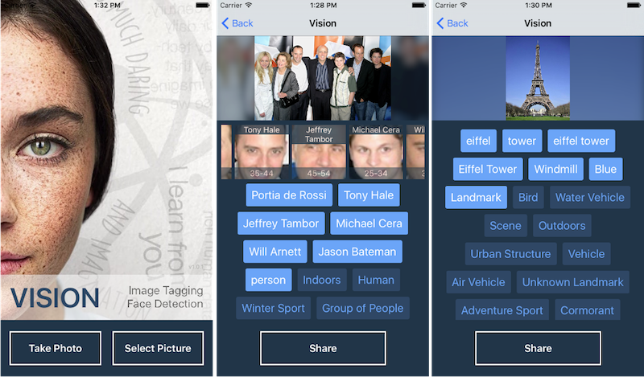
Computer vision use cases
Facial recognition: We use facial recognition daily.
Taking a photo and applying effects by using your smartphone.
Tagging friends on social media.
Notes:
Facial recognition is one of the most-used features of CV. It is often used in smartphones when you take a photo or apply effects. Another widely used feature is tagging friends on social media. These features use face recognition and facial identification, in which a face is recognized from the image and identifies the person in the image. A facial recognition feature can recognize faces in an image, as shown in the figure.

Slide 16
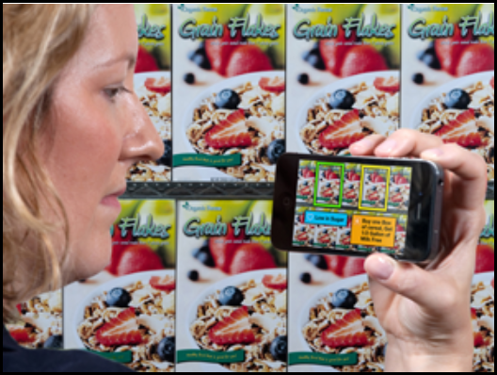
Computer vision use cases (cont.)
Augmented reality: Manipulation and addition of a system-generated image (3D or 2D) as an overlay of a user’s view.
Examples: Google Glass, emoji filters in some mobile apps, and Pokémon Go.
Mobile shopping applications will give in-store shoppers instant product details and promotions through their mobile devices.
Notes:
Augmented reality (AR) is the manipulation and addition of a system-generated image (3D or 2D) as an overlay of a user’s view. Examples include Google Glass, emoji filters in some mobile apps, and Pokémon Go.
While in-store shopping accounts for 92 percent of retail volume, consumers are expecting the same levels of personalization and customization that they do when they shop online; 58 percent of consumers want in-store product information and 19 percent of consumers are already browsing their mobile devices while in-store. CV and AR technology can bring all the benefits of online shopping into traditional shops. By creating augmented reality mobile shopping applications (apps), as shown in figure, in-store shoppers immediately learn about product details and promotions through their mobile devices.
For more information on AR, watch the video “IBM augmented reality shopping app” at https://youtu.be/EAVtHjzQnqY

Slide 17
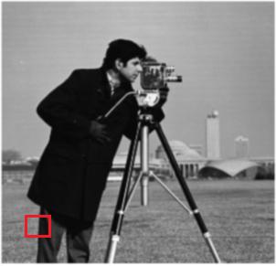

Image representation
Images are stored as a 2D array of pixels on computers.
Each pixel has a certain value that represent its intensity.
Example of grayscale representation:
Image is black and white with shades of gray in between.
Pixel intensity is a number between 0 (black) and 255 (white).
int[ ][ ] array = { {255, 170, 170, 0},
{220, 80, 80, 170},
{255, 80, 0, 0},
{175, 20, 170, 0} };
Notes:
It is important to understand how images are stored and represented on computer screens. Images are made of grids of pixels, that is, a two-dimensional (2D) array of pixels, where each pixel has a certain value that represents its intensity. A pixel represents a square of color on the user’s screen. Colors can be represented in image in various ways.
If the image is grayscale, that is, black and white with shades of gray in between, the intensity is a number in the range 0 - 255, where 0 represents black and 255 represents white. The numbers in between these two values are different intensities of gray.
For example, in the picture in the slide, assume that you selected a small square from the image (the part in the red square). The pixel representation for it is in black, white, and shades of gray. To the right of the picture is the numeric values of these pixels in a 2D array.
┌ Note ─────────────────
The 256 scaling is a result of using 8-bit storage (2⁸ =256).
└────────────────────
References:
Data Representation
https://www.csfieldguide.org.nz/en/chapters/data-representation/
Colour Models
https://www.sqa.org.uk/e-learning/BitVect01CD/page_36.htm
Image reference
https://www.mathworks.com/help/examples/images/win64/SegmentGrayscaleImageUsingKMeansClusteringExample_01.png

Slide 18
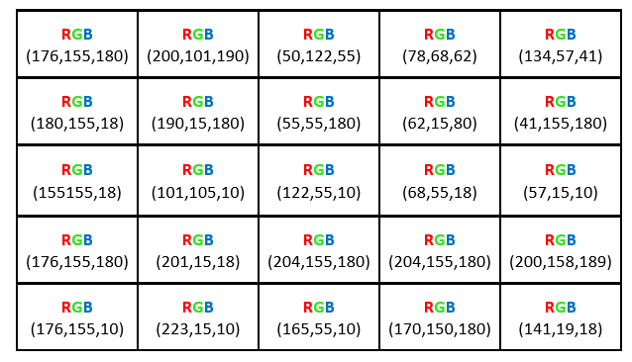
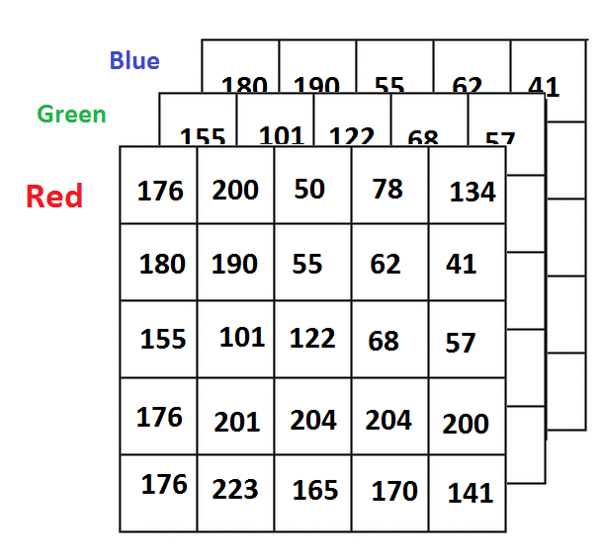
Image representation (cont.)
Example of color representation:
The pixel color is represented as a mix of Red, Green, and Blue.
The pixel intensity becomes three 2D arrays or one 2D array, where each entry is an object containing the 3 color values of RGB
three 2D array
one 2D array
Notes:
Many color models are available for colored images. The best-known model is RGB, where the color of the pixels is represented as a mix of Red, Blue, and Green color channels. The value of the pixel intensity is represented as three 2D arrays that represent the three color channels, where each color value is in the range 0 – 255. The color value represents different intensities of the colors and all the colors that you see on the screen. The number of color variations that are available in RGB is 256 * 256 *256 = 16,777,216 possible colors.
Depending on the data structure used that image appears as
Three 2D arrays, where each 2D array represents the values and intensities for one color. The image is a combination of all three arrays.
One 2D array, where each entry in the array is an object that contains three color values of RGB.
References:
Data Representation
https://www.csfieldguide.org.nz/en/chapters/data-representation/
Colour Models
https://www.sqa.org.uk/e-learning/BitVect01CD/page_36.htm
How MATLAB Represents Pixel Colors
https://www.mathworks.com/company/newsletters/articles/how-matlab-represents-pixel-colors.html

Slide 19
Computer vision pipeline

Slide 20
Computer vision pipeline
The steps and functions that are included are highly dependent on the application.
Here is a conventional visual pattern recognition pipeline.
Image Acquisition
Pre-Processing
Segmentation
Feature Extraction & Selection
Classification
Notes:
The steps and functions that are included in a CV system algorithm pipeline are highly dependent on the application. The application might be implemented as a stand-alone part of a system and might apply to only a certain step of the pipeline, or it can be a larger application, that is, an end-to-end application that takes certain images and then applies all of the steps and functions in the pipeline.
Reference:
Hardware Architecture for Real-Time Computation of Image Component Feature Descriptors on a FPGA
https://www.researchgate.net/publication/273596152_Hardware_Architecture_for_Real-Time_Computation_of_Image_Component_Feature_Descriptors_on_a_FPGA

Slide 21
Computer vision pipeline (cont.)
Image acquisition:
The process of acquiring images and saving them in a digital image format for processing.
Images often use common formats, such as .jpeg, .png, and .bmp.
Images are 2D images that are stored as arrays of pixels according to their color model.
Notes:
Image acquisition
Image acquisition is the process of acquiring images and saving them in a digital image format for processing in the pipeline.
Images are acquired from image sensors, such as commercial cameras. Other types of light-sensitive devices can be used to capture different types of images. Other image sensors include radar, which uses radio waves for imaging.
Depending on the type of the device, the captured image can be 2D, 3D, or a sequence of images. These images often use common formats, such as .jpeg, .png, and .bmp.
Images are stored as arrays of pixels according to their color model.
Reference:
System methods
https://en.wikipedia.org/wiki/Computer_vision#System_methods

Slide 22
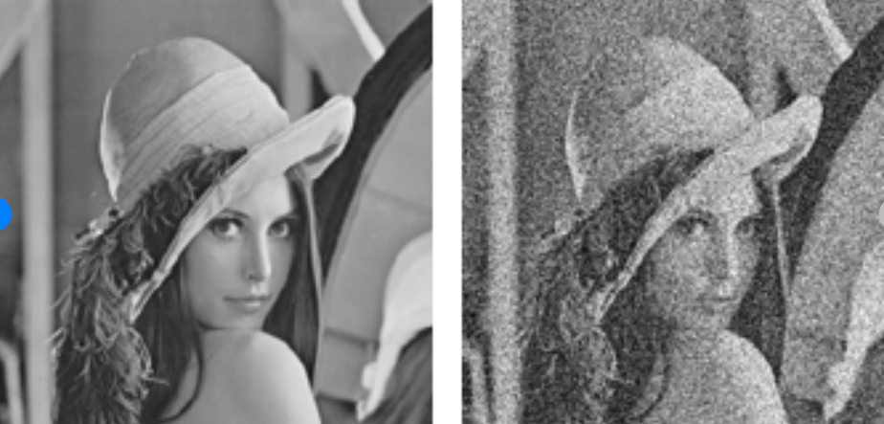
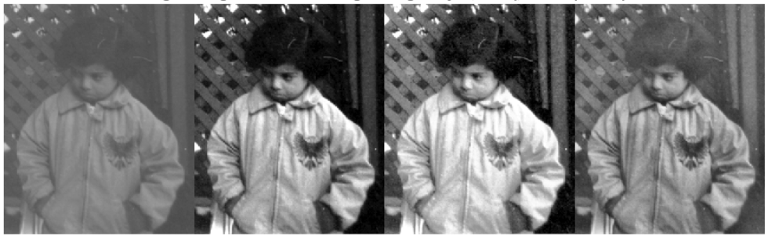
Computer vision pipeline (cont.)
Pre-processing:
Preparing the image for the processing stage
Examples:
Resizing images
Noise reduction
Contrast adjustment
Notes:
Pre-processing:
This stage focuses on preparing the image for the processing stage.
Examples:
Images are resized as a form of normalization so that all images are the same size.
Noise reduction reduces noise that represents false information in the image, as shown in the slide.
Contrast adjustment helps with the detection of image information. In the images of the little girl, each image represents a different contrast adjustment.
Image source: https://www.mathworks.com/help/images/contrast-adjustment.html
Reference:
System methods
https://en.wikipedia.org/wiki/Computer_vision#System_methods

Slide 23
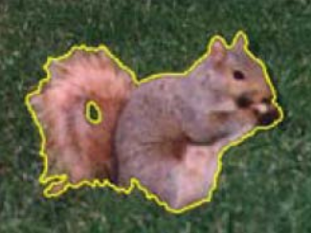
Computer vision pipeline (cont.)
Segmentation:
Partitioning an image into regions of similarity.
Grouping pixels and features with similar characteristics together.
Helps with selecting regions of interest within the images. These regions can contain objects of interest that you want to capture.
Segmenting an image into foreground and background.
(Cremers, Rousson, and Deriche 2007) © 2007 Springer
Notes:
Segmentation
The position of the image segmentation phase is not fixed in the CV pipeline. It might be a part of the pre-processing phase or follow it or be part of the feature extraction and selection phase or follow them.
Segmentation is one of the oldest problems in CV and has the following aspects:
Partitioning an image into regions of similarity.
Grouping pixels and features with similar characteristics together.
Helps with selecting regions of interest within the images. These regions can contain objects of interest that you want to capture.
Segmenting an image into foreground and background to apply further processing on the foreground.
Image citation: Cremers, D., Rousson, M., & Deriche, R. (2007). A review of statistical approaches to level set segmentation: integrating color, texture, motion and shape. International journal of computer vision, 72(2), 195-215.
References:
Computer vision
https://en.wikipedia.org/wiki/Computer_vision
Computer Vision: Algorithms and Applications
http://www.cs.ccu.edu.tw/~damon/tmp/SzeliskiBook_20100903_draft.pdf
Segmentation of Images
http://www.cse.iitm.ac.in/~vplab/courses/CV_DIP/PDF/lect-Segmen.pdf

Slide 24
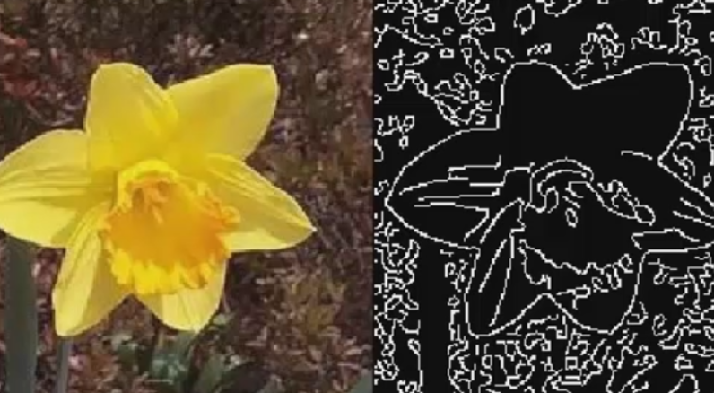
Computer vision pipeline (cont.)
Feature extraction and selection:
Find distinguishing information about the image.
Image features examples: distinct color in an image or a specific shape such as a line, edge, corner, or an image segment.
Notes:
Feature extraction and selection
In computer vision, a feature is a measurable piece of data in your image, which is unique to this specific object. It can be a distinct color in an image or a specific shape such as a line, edge, corner, or an image segment. A good feature is used to distinguish objects from one another.
The objective is to transform the raw data (image) into a features vector so that the learning algorithm learns the characteristics of the object.
Typical examples of such features are:
Lines and edges: These features are where sharp changes in brightness occur. They represent the boundaries of objects.
Corners: These features are points of interest in the image where intersections or changes in brightness happens.
These corners and edges represent points and regions of interest in the image.
Brightness in this context refers to changes in the pixel intensity value.
References:
Computer Vision Pipeline, Part 1: the big picture
https://freecontent.manning.com/computer-vision-pipeline-part-1-the-big-picture/
The Computer Vision Pipeline, Part 4: feature extraction
https://freecontent.manning.com/the-computer-vision-pipeline-part-4-feature-extraction/
Detection
https://en.wikipedia.org/wiki/Feature_(computer_vision)#Detectors
Edge Detection
https://www.mathworks.com/discovery/edge-detection.html
Computer vision
https://en.wikipedia.org/wiki/Computer_vision
Image reference: https://www.mathworks.com/discovery/edge-detection.html

Slide 25



Computer vision pipeline (cont.)
Some extracted features might be irrelevant or redundant.
Feature selection follows feature extraction.
Feature selection is choosing a feature subset that can reduce dimensionality with the least amount of information loss.
All Features
Selection
Techniques
Selected
Features
Notes:
For feature extraction, all the features in the image that could be extracted are present. Now, start selecting the features that are of interest. Some extracted features might be irrelevant or redundant.
Here are some reasons to perform feature selection:
Reduce the dimensions of the features that were extracted from the image.
Avoid overfitting when training the model with the features.
Create simpler models with less training time.
References:
Feature selection
https://en.wikipedia.org/wiki/Feature_selection
Application of high-dimensional feature selection: evaluation for genomic prediction in man
https://www.nature.com/articles/srep10312

Slide 26
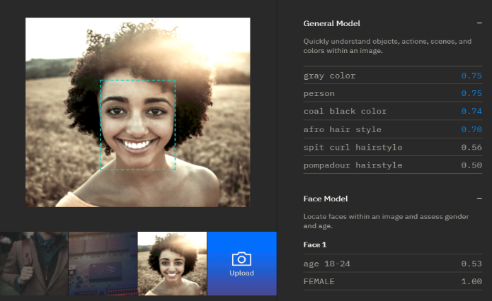
Computer vision pipeline (cont.)
Classification:
The extracted features are used to classify the image.
More processing might be done on the classified images to identify more features from the image.
Example: After face detection, identify features on the face, such as hair style, age, and gender.
Notes:
Classification: Image classification is a practice in computer vision. It focuses on classifying an image according to its visual content.
Further processing is done on the classified images to identify more features from the image. For example, after the image is classified to detect the face region, identify features on the face such as hair style, age, and gender.
Reference:
Image Classification
https://www.sciencedirect.com/topics/computer-science/image-classification

Slide 27
Decision making
Apply logic to make decisions based on detected images.
Examples:
Security application: Grant access based on face recognition.
In a greenhouse environment, a notification is sent to the engineers to act if a plant is detected as suffering from decay.
Notes:
Decision making
After getting the output from the CV pipeline, users can apply logic that is based on the findings to make decisions based on detected images.
For example, in security applications, the system can decide to grant access to a person if a face that is detected is identified as the owner of a facility.
Another example is in a greenhouse environment, where a notification is sent to the engineers to act if a plant is detected as suffering from decay.

Slide 28
Thanks
Any questions?

